Slide 1
GLayout: A Pythonic Framework for Analog Layout Design
Anhang Li (anhangli@umich.edu)
Mehdi Saligane (mehdi@umich.edu)

Slide 2

Speaker Information
Anhang Li
M.S. degree in EE at Columbia University, NY in 2022.
Currently pursuing Ph.D. in ECE at the University of Michigan.
Instructor: Mehdi Saligane.
The presented software is a part of the OpenFASoC Project.
Main contributors: Ali Hammoud, Wen Tian, Ayushman Tripathi,
Karthik Lakshmanan, Harsh Khandeparkar, and Ryan Wans

Slide 3
Curriculum
Introduction
GLayout Setup & Simple Design Walkthrough
Running DRC, LVS, and Post-Layout Simulations
Real-World Application Example

Slide 4
Introduction

Slide 5
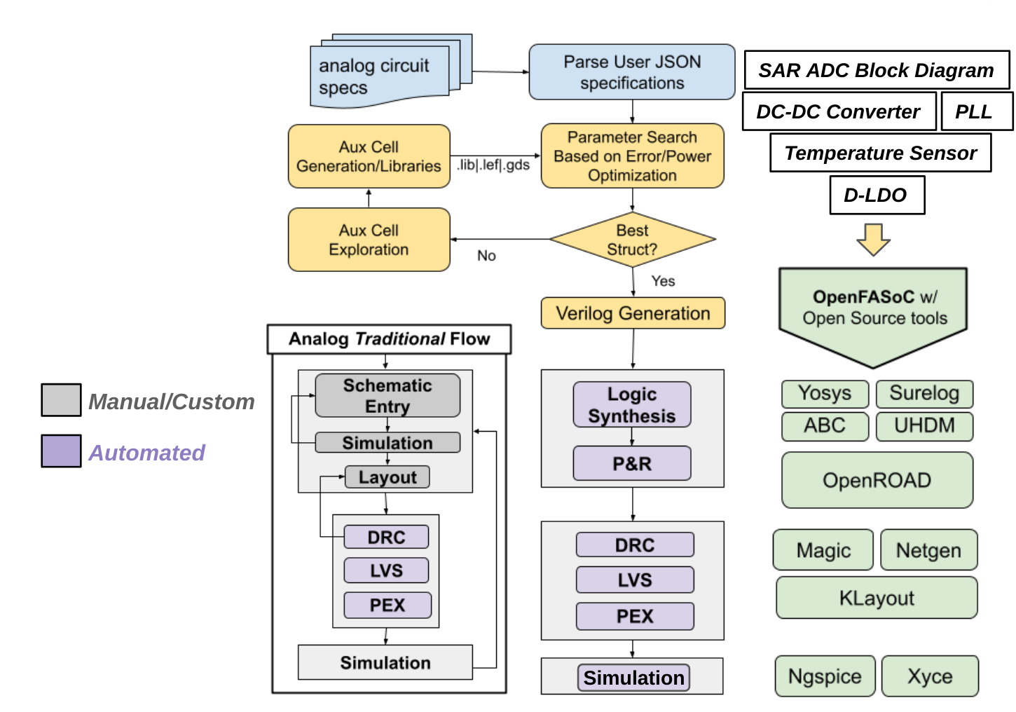
Template Generator Approach
Project OpenFASoC
analog “Aux-cells” + APR
“Aux-cells” can be modified or swapped, just provide GDS
PDK generic
Optimize design area, power, other metrics based on specification
Spec to model lookups
Notes:
In michigan we have developed previous template projects with our fully automated SOC.
The fasoc approach is to Combine analog “Aux-cells” with auto generated components by leveraging cell-based APR tools. For the open-source flow we are using Openroad for this.
“Aux-cells” can be modified or swapped, just provide GDS
Support new PDK by implementing “Aux-cells”
Optimize design area, power, other metrics based on specification
The user inputs some specification which is then looked up in some pre-constructed models
Generally these models are built from simulation data or tapeout results
The advantage of this approach is speed, we are just doing a model lookup, so it is fast and highly scalable

Slide 6
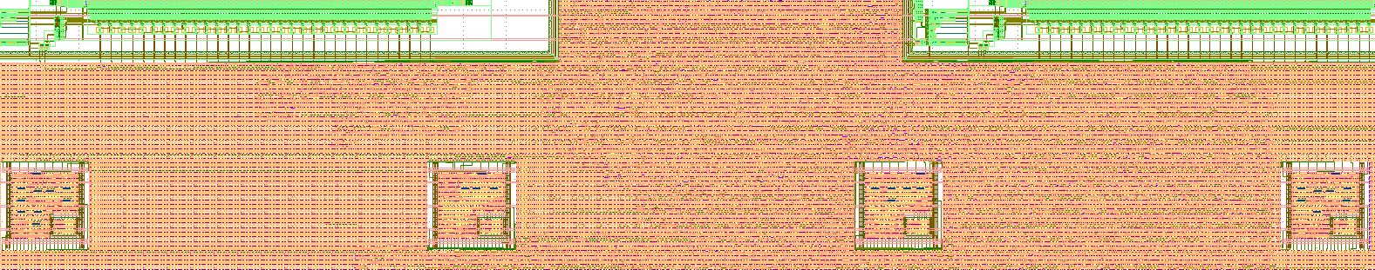
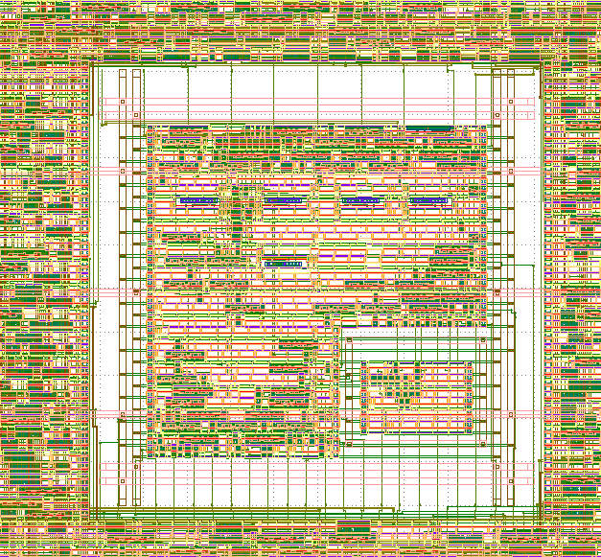
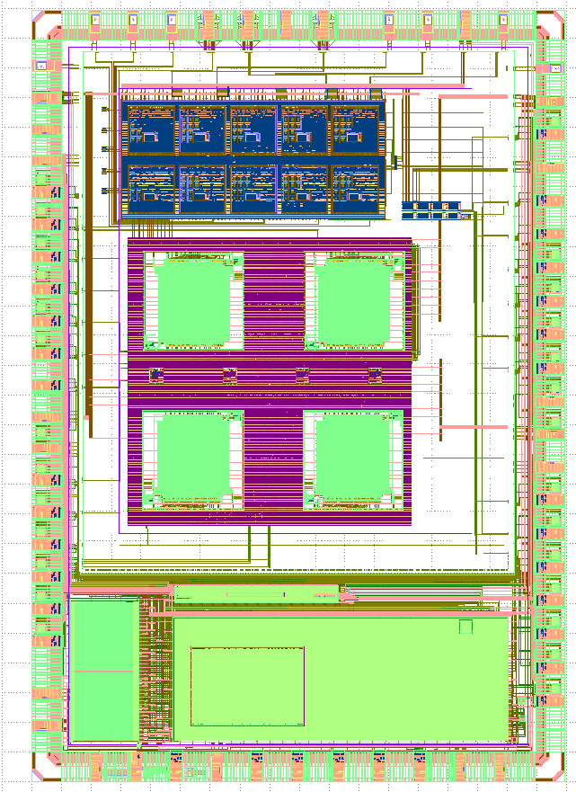
Integrated Temperature Sensors in Sky130
Highly tunable V_{REF} with trimming bits
Sensing elements are sitting on a second voltage domain
µP with Embedded Temperature Sensors
The temperature sensor generator uses a fully open source flow
Notes:
We have integrated 4 sensors connect to the opentitan’s IBEX core through tilelink.
As you can see we were able to create voltage domains and had the sensing elements of the temperature sensor generator sit on a separate area with its own on-chip generated voltage.
Non default rule have been also enabled in OR, we added on top of that py scripting to connect custom nets to power rings which you can see on the left which is essentially doing special routing
All of these features are expected to be included directly in the OR database. And this model seems to be working great following the software model with a lot of iterations and improvements.

Slide 7
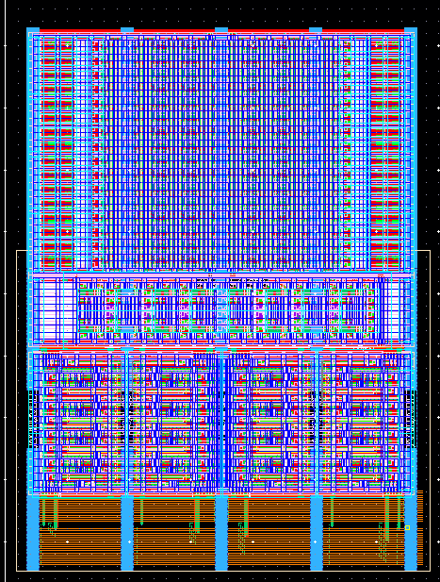
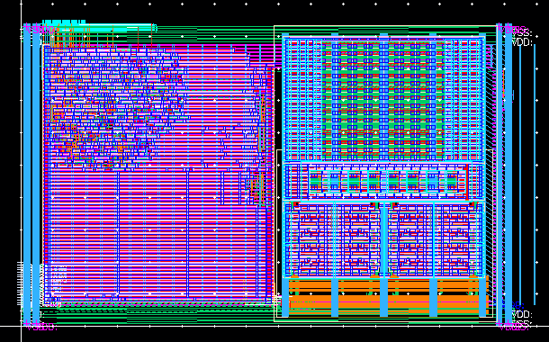
Multi-Phase High Speed PLL in GF12
Digital Flow + Custom Analog Cells
Parameterized Reusable Design
256x Unit Currents
16-stage VCO Core
Controller & Decap
Level Shifter + Output Buffer + TDC
DCO

Slide 8
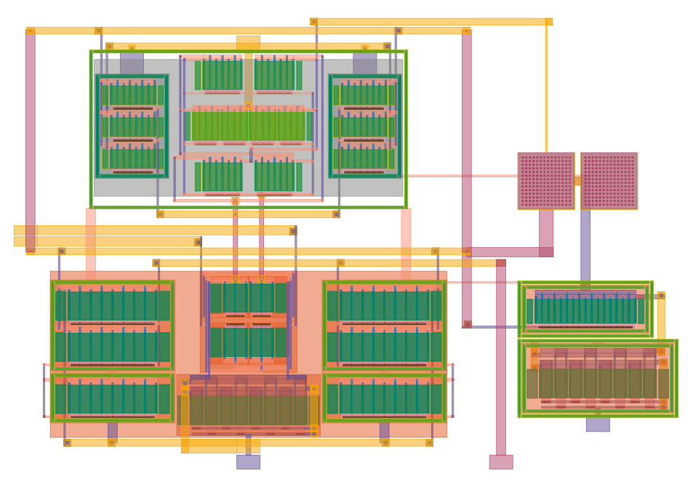
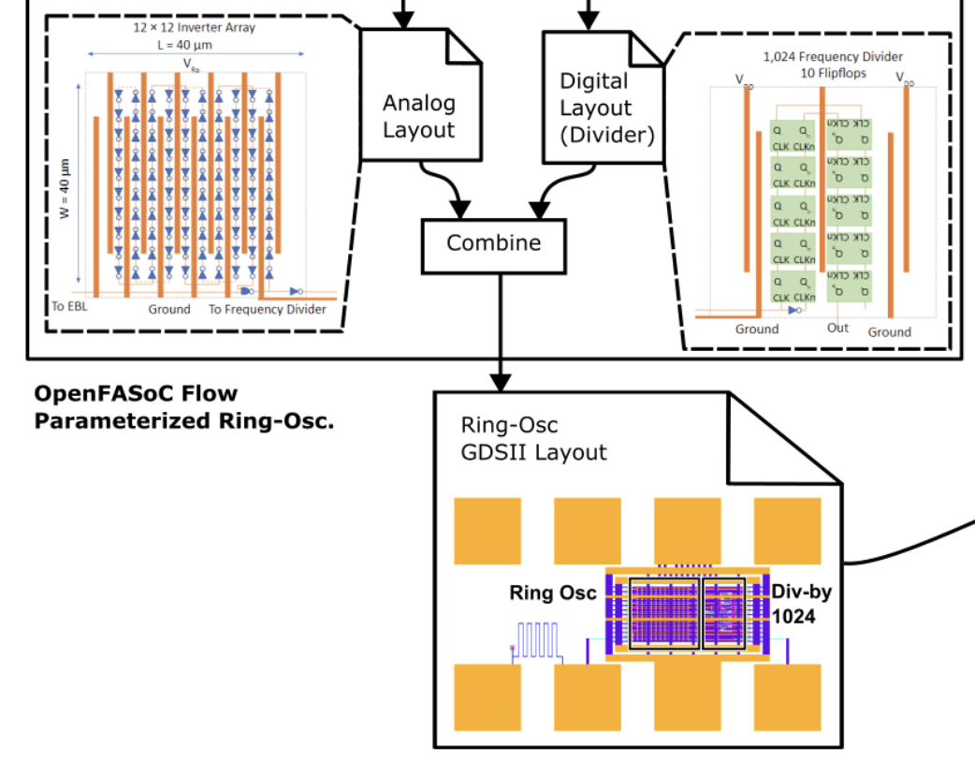
Challenges: Certain Analog Components need Parameterized Transistor-Level Layout
VS
Ring OSC
Grid-based Layout is good enough
OPAmp
Need Transistor-Level Layout
Dummy Transistors …
Common Centroid Placement …
Routing Parasitics…

Slide 9
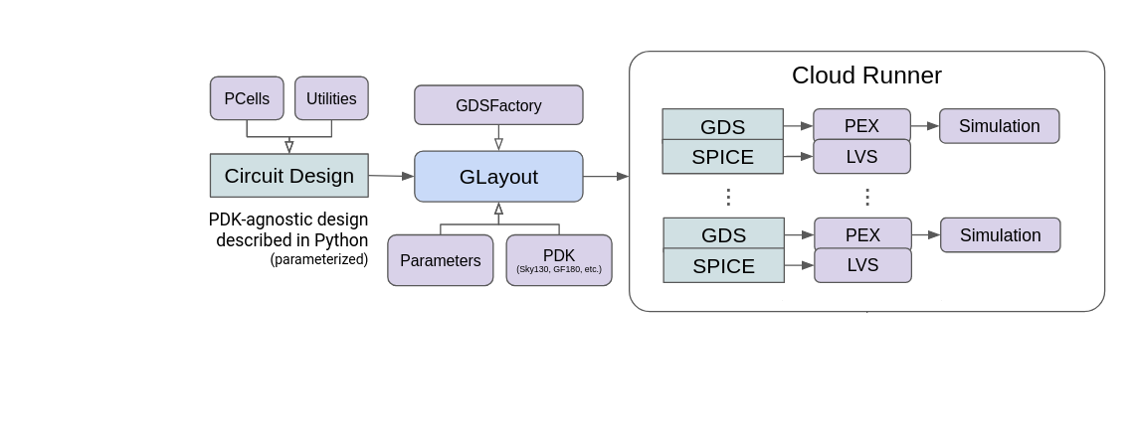
GLayout: A Pythonic Framework for Analog Layout Design
Run >1k designs in parallel
The user code a circuit design in Python programming language.
GLayout generates layout and netlist from the code.

Slide 10

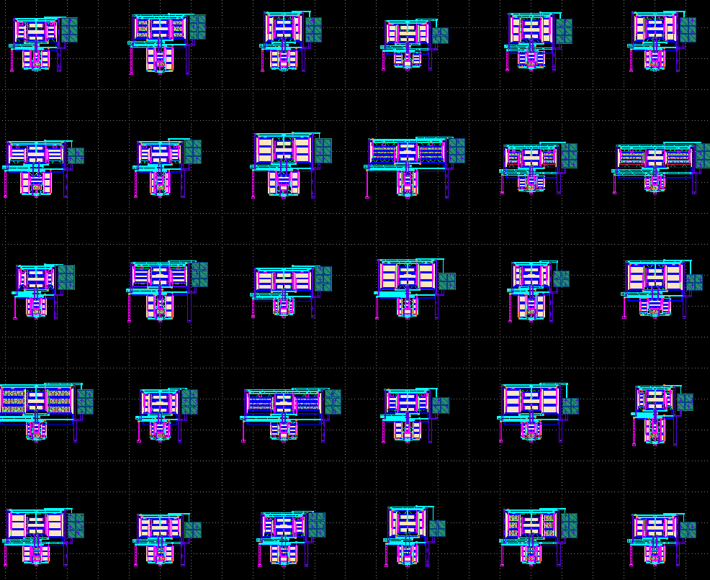
GLayout: A Pythonic Framework for Analog Layout Design
GLayout is built using only open-source tools and PDKs
Can be deployed on your local machine or a cloud server with no restrictions.
Run 8000 tasks in parallel.

Slide 11
GLayout Setup
&
Simple Design Walkthrough

Slide 12
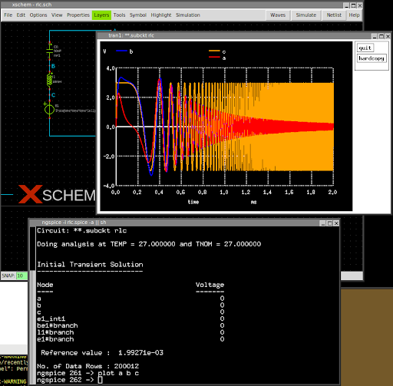

A Quick Overview of the Open-Source Ecosystem
https://ngspice.sourceforge.io/
ngSpice is a high performance SPICE circuit simulator
Notes:
The community have established a complete set of silicon design tools

Slide 13

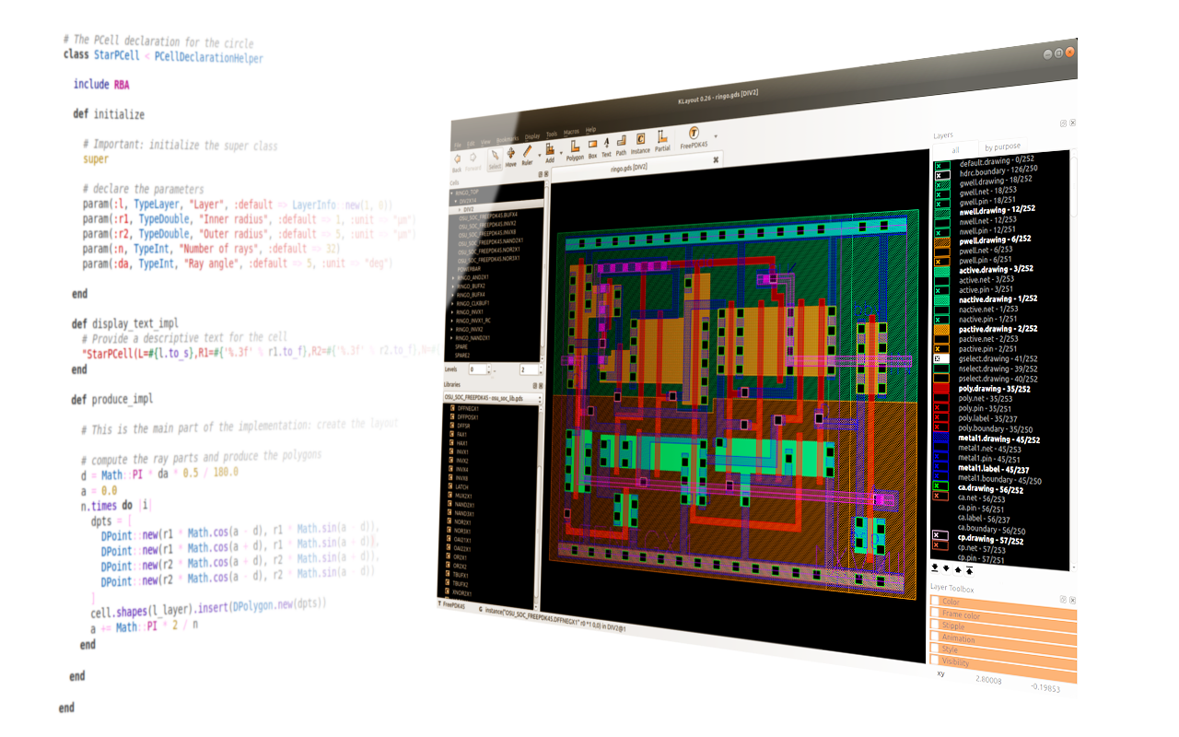
A Quick Overview of the Open-Source Ecosystem
https://www.klayout.de/
KLayout is a full-featured Layout editor.
With LVS & DRC capabilities
Notes:
The community have established a complete set of silicon design tools

Slide 14

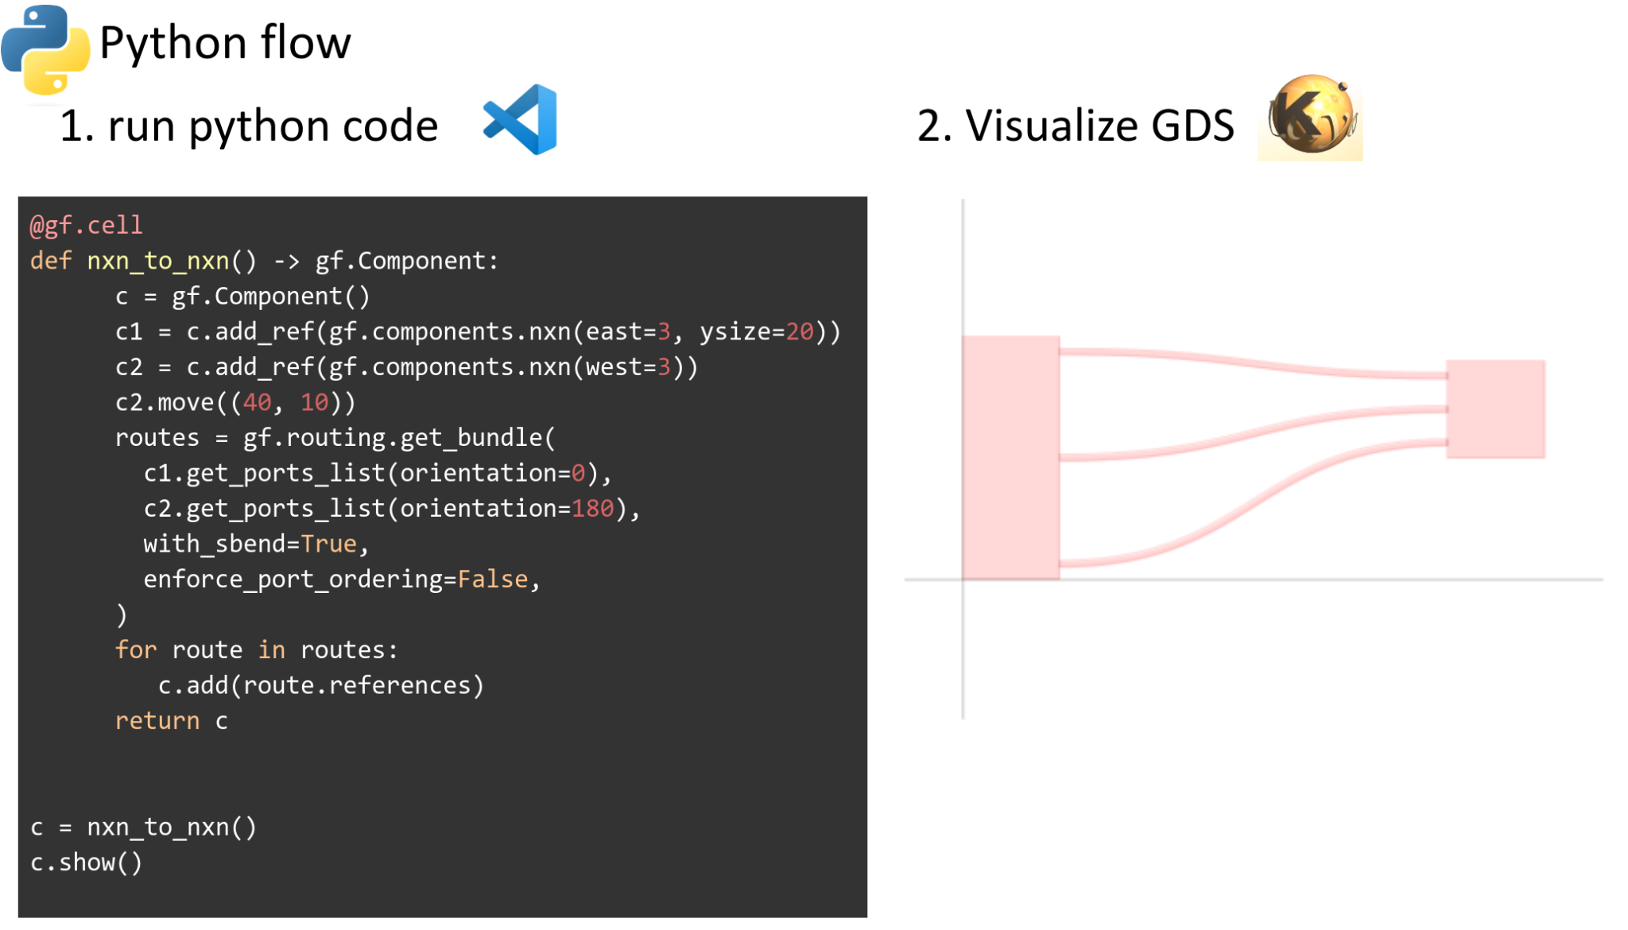
A Quick Overview of the Open-Source Ecosystem
https://gdsfactory.github.io/
GDSFactory is a Python-based GDSII layout manipulation tool
Notes:
The community have established a complete set of silicon design tools

Slide 15
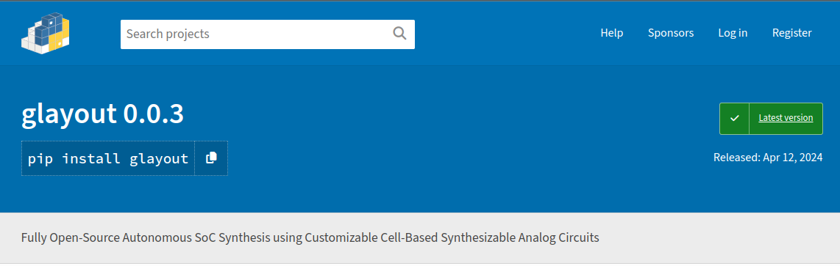
Environment Setup
GLayout is published as a PyPI package.
Users can download it automatically using Python’s package manager
https://pypi.org/project/glayout/

Slide 16
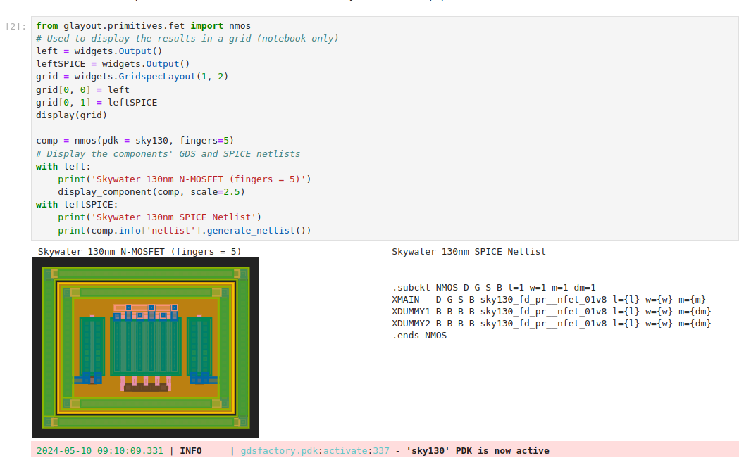
Live Demo 1: Overview of the Primitives
Glayout_1_overview.ipynb
Execute the code on your local machine or

Slide 17
Live Demo 2: Build a Diff-Pair using MOSFET Primitives
TODO: Open the notebook and walk through the simplified version of the diff pair generator.
Highlight the hierarchical aspect
(~6 minutes)

Slide 18
Running DRC, LVS,
and Post-Layout Simulations

Slide 19
Running DRC and LVS
TODO: Open the notebook run DRC and LVS on a simple block (diff pair?). Shouldn’t take too long to run. Explain how the DRC and LVS are implemented
(~10 minutes)

Slide 20
Running Post PEX Simulation
TODO: Open the notebook run PEX on a simple block (diff pair?). Because the simulation is probably very slow, we can show some existing results (from the opamp)
(~10 minutes)

Slide 21
Real-World Application

Slide 22
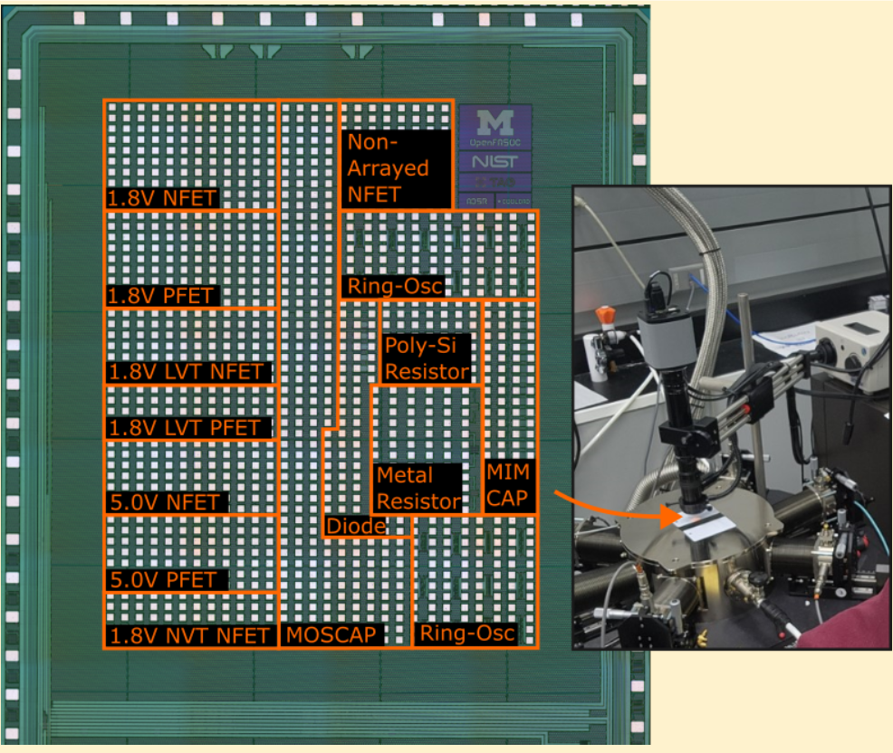
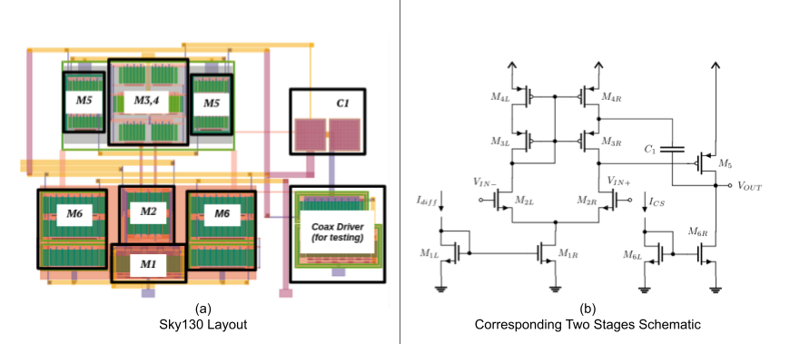
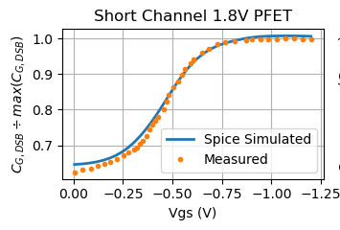
Making OPAmps for Cryogenic Applications
Circuit Design
Silicon Measurement
BSIM Model @ 4K

Slide 23
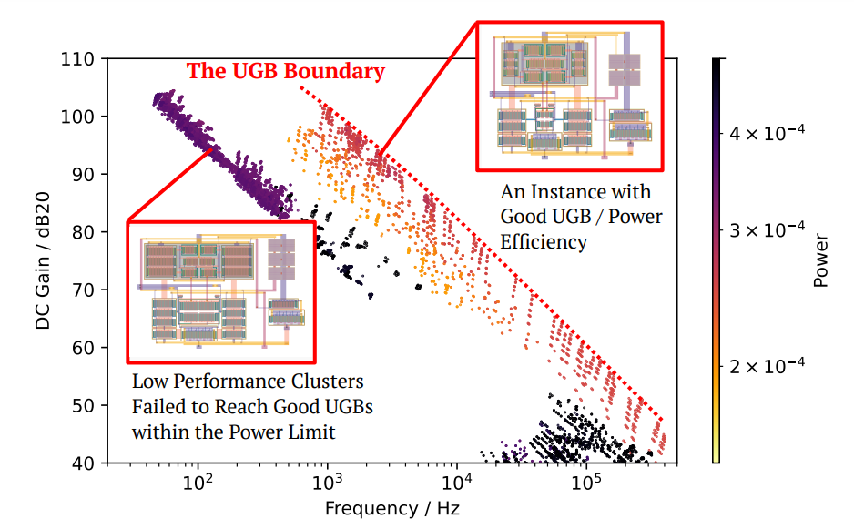
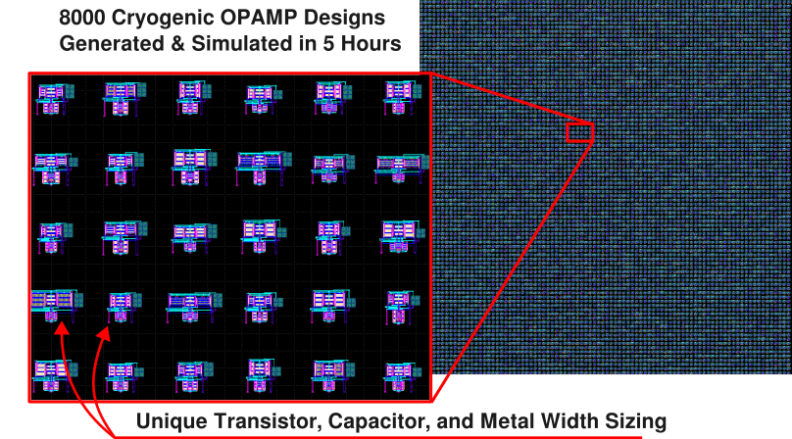
Application: An OPAmp Generator for Cryogenic
Construct a rich database containing 8000 different designs in 5 hours

Slide 24
Thank You !

